Slide 1

STUDENT ADAPTABILITY LEVEL IN ONLINE EDUCATION.
ADEOLUWA IDOWU
ABDULSALAM MISTURA
ANU KEHINDE

Slide 2
EXECUTIVE SUMMARY
Online Education has become a buzzword since covid-19 hit the world. Most of the educational institutions went online to continue educational activities, in this dataset, we have collected students information of three different levels (High-school, college, university).
The following insights were covered in this project:
How gender impacts the adaptability level to online education during the covid era, our research shows that both genders adapt to online learning at a similar rate
The non-governmental institutions has higher adaptability rate compared to the government institution
The students residing in the urban area has more adaptability level to online education than those in the Rural area, generally, most of the student population resides in the urban area.

Slide 3
DATASET DESCRIPTION
We used a dataset from schools in Bangladesh, we analyzed the dataset called “student adaptability level in an online education”, It contains 1205 rows and 14 columns which includes Age, Gender, Location, Financial condition, Adaptivity level etc. IT Students, load shedding, internet quality, type of device used while attending the class.
The dataset was gotten from online and offline survey from different level of students which include schools, colleges and university.
Data cleaning was performed which involves changing the location of students to rural and urban, Adaptivity level from mid, rich and poor to middle, lower and upper.

Slide 4
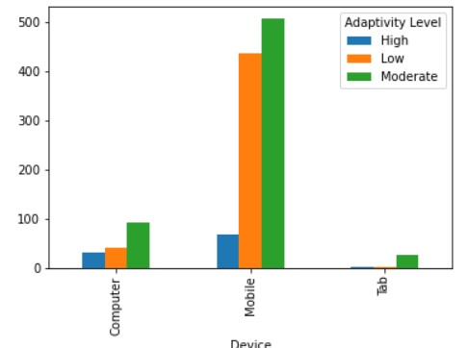
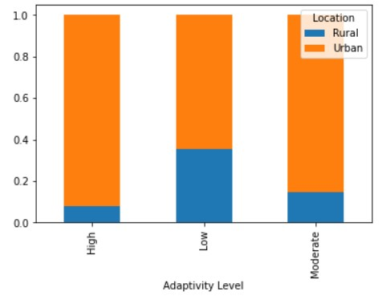
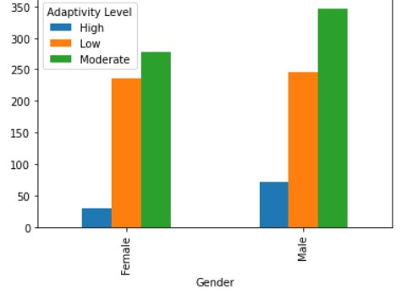
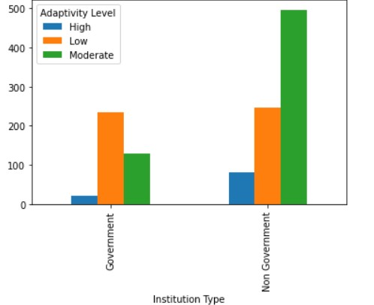
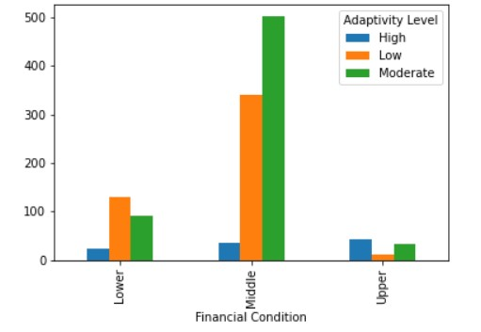
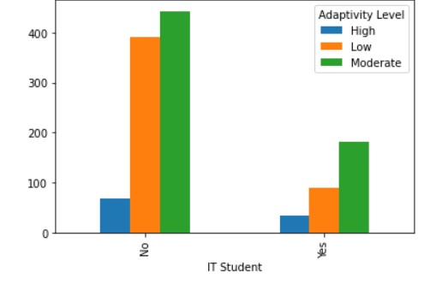
VISUALIZATION

Slide 5
CONCLUSION
Men are easier to adapt to new knowledge, the level of poor adaptation between men and women is approximately the same.
the best adaptation is shown at the age of 21-25, and 11-15, the worst - after 26 years and in the interval from 16 to 20 years. Worse adaptation to new knowledge can be explained by social and physiological factors.
From the subjects we can conclude that the students adapt to online education because they use more of their mobile Devices and can easily connect to class at their convenient time.
The financial status of the family influences the adaptability rate of the students to online education as most of the students with upper financial status has high adaptability rate.
The level of adaptation to new knowledge also depends on the quality of the Internet which includes the 4G Network

